Slide 1

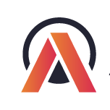
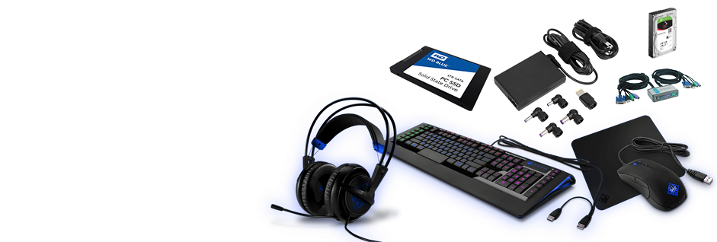

AtliQ Hardware
  AtliQ Hardwares is a rapidly growing consumer electronics company operating across multiple countries. The company offers a wide range of hardware products catering to both individual consumers and enterprise clients. With its strong global presence and expanding market share, AtliQ aims to strengthen its decision-making process through data-driven strategies to maintain its competitive edge.

Slide 2
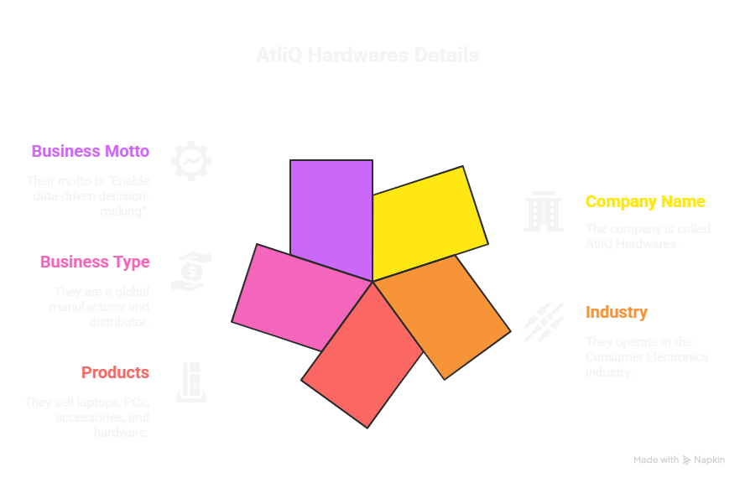
Problem Statment
AtliQ Hardware and discuss its business model. It is a consumer goods electronics company having operations in various countries. Their business is growing rapidly and they still rely on excel files for data analytics. Excel files are hard to consume and not effective in generating insights. Also due to the lack of effective analytics the company faced a major loss in Latin America.
Despite its rapid growth, AtliQ Hardwares continues to rely heavily on Excel-based reporting for analytics and business insights. This traditional approach has proven inefficient for handling large-scale data, leading to delays in decision-making and limited visibility into key performance metrics. The absence of an advanced analytics system has resulted in missed opportunities and significant financial losses in the Latin American market.
To overcome these challenges, AtliQ Hardwares needs to implement a modern, scalable data analytics solution that enables real-time insights, performance tracking, and strategic decision-making across global operations.

Slide 3
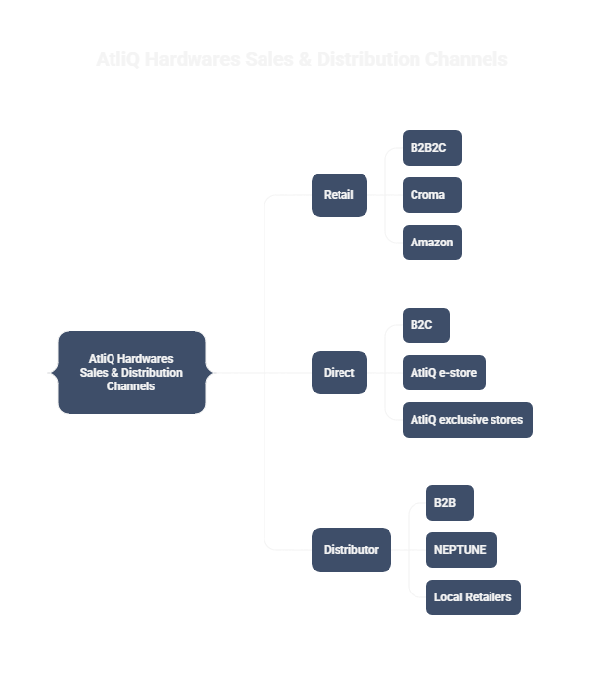
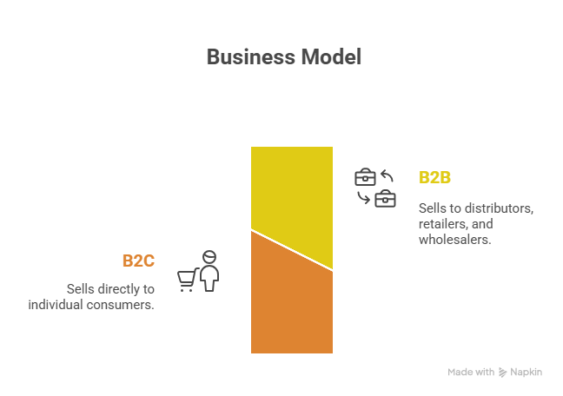
Business Model of AtliQ Hardwares
B2B + B2C
B2B: Sells to distributors, retailers, and wholesalers.
B2C: Sells directly to customers through e-commerce and retail partners.

Slide 4
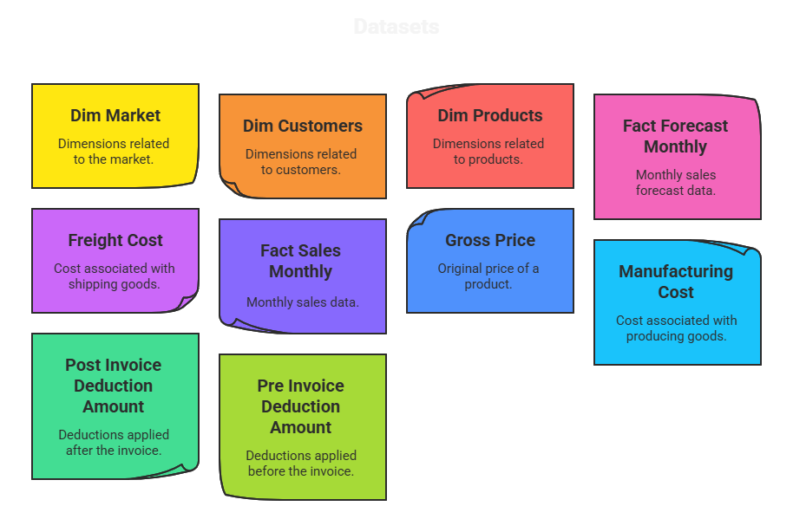
Dataset Details
WARDIERE BUSINESS

Slide 5
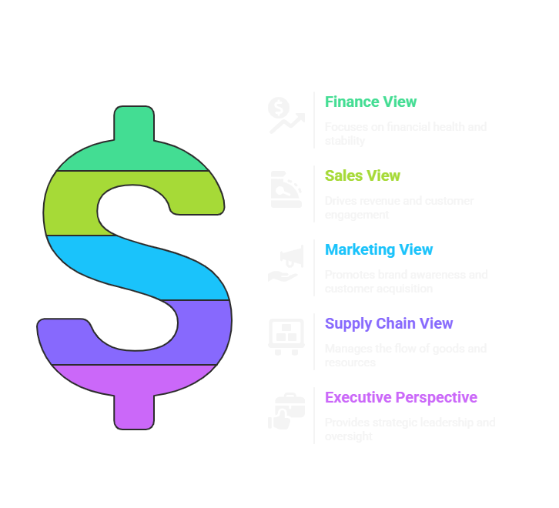
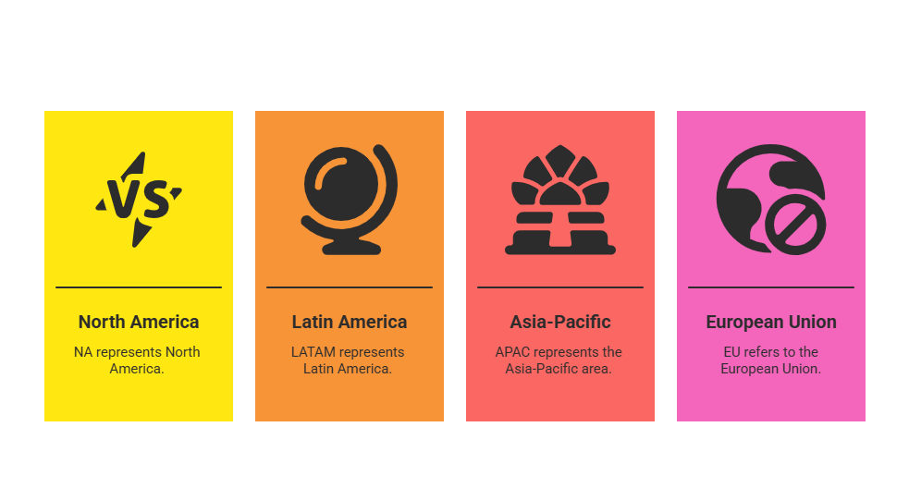
Overview
All Views
Regions
RGB
CMYK
Hex
RGB
CMYK
Hex
RGB
CMYK
Hex
RGB
CMYK
Hex
RGB
CMYK
Hex
RGB
CMYK
Hex
RGB
CMYK
Hex
RGB
CMYK
Hex
RGB
CMY
Hex

Slide 6
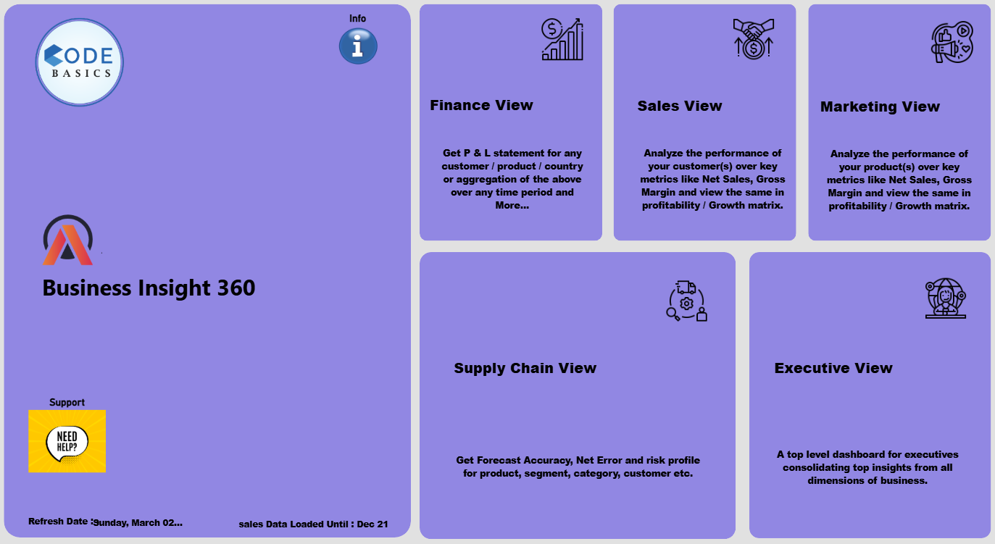
Home Page

Slide 7
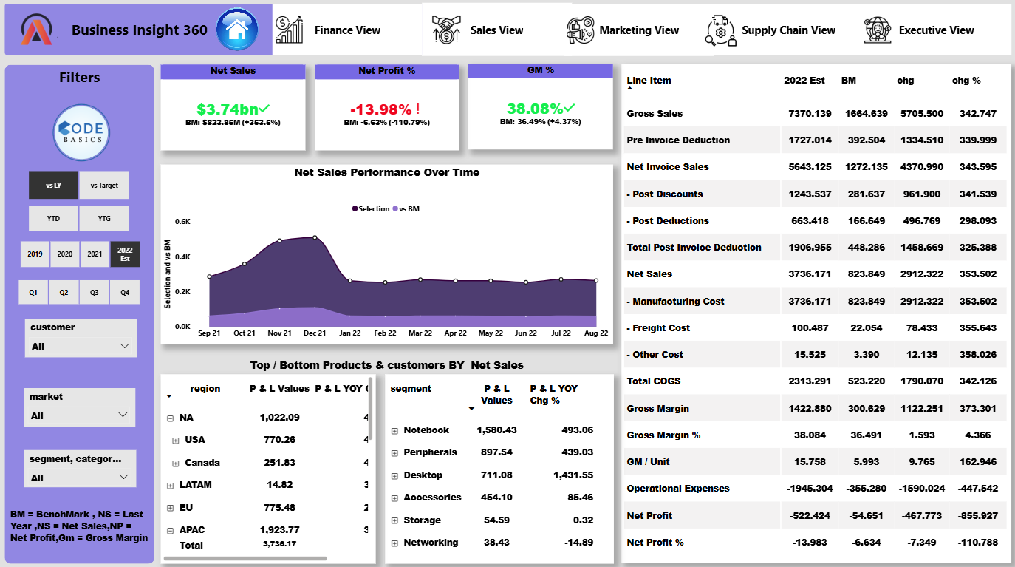
Finance View

Slide 8
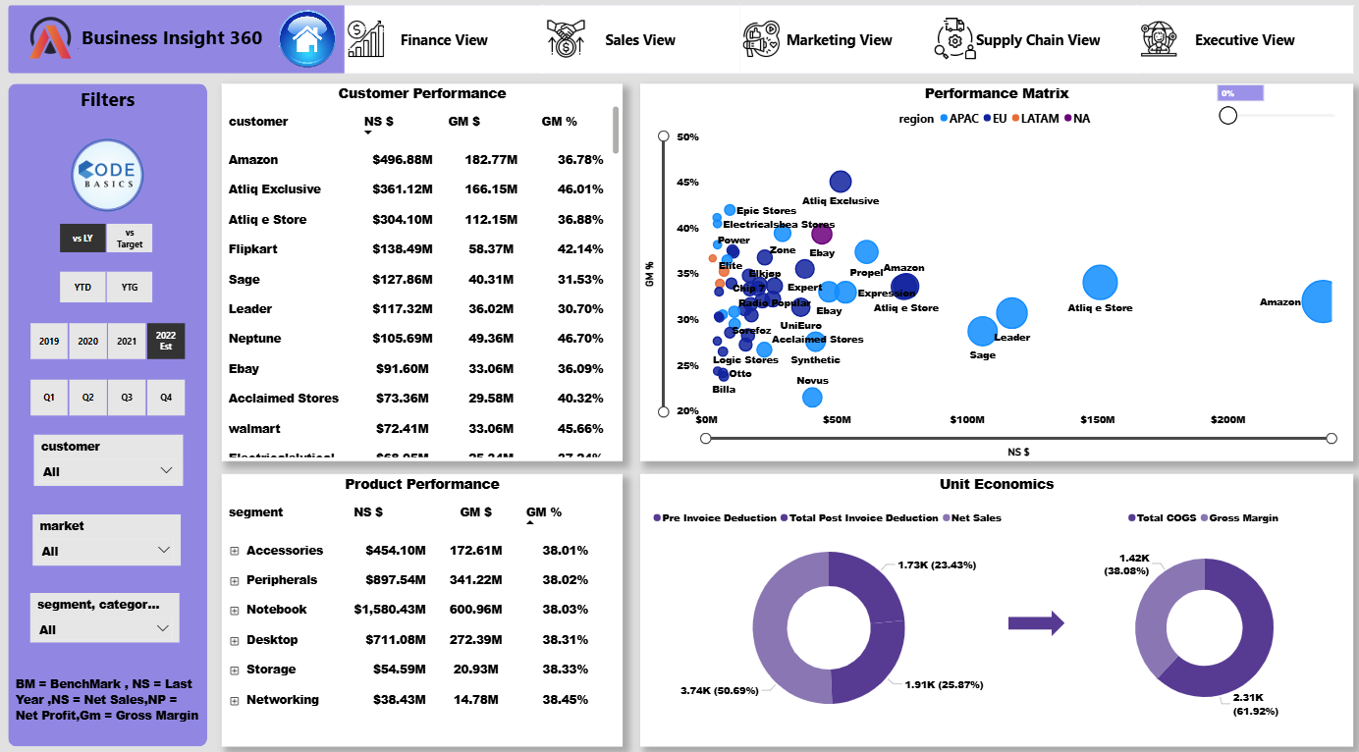
Sales View

Slide 9
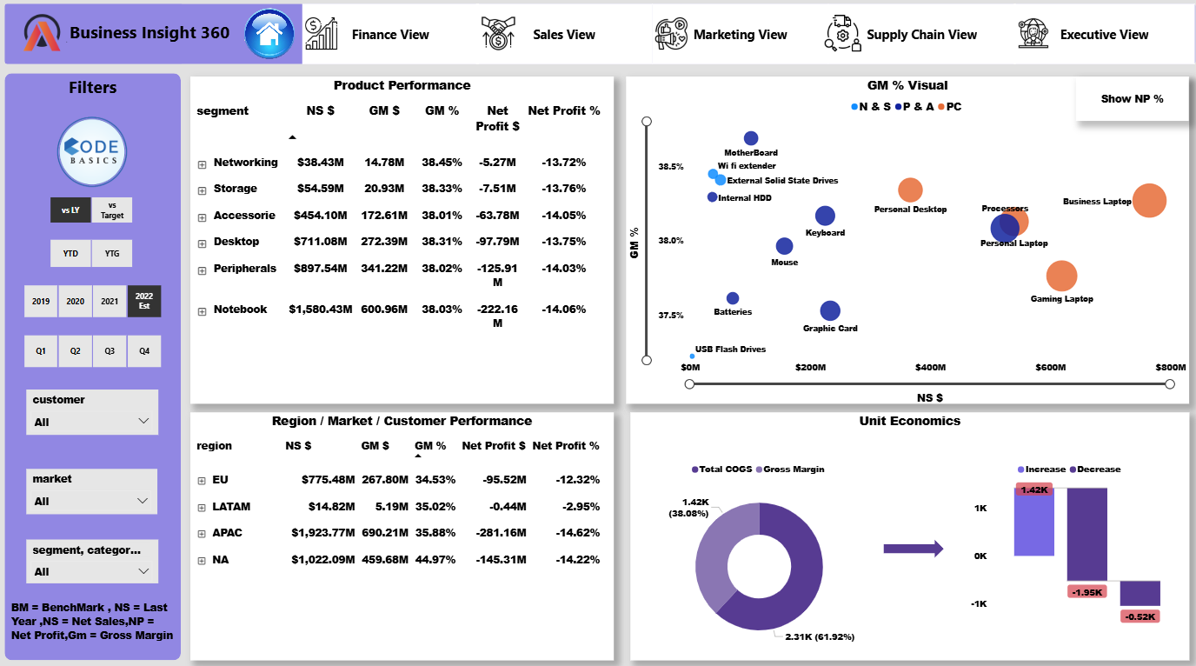
Marketing View

Slide 10
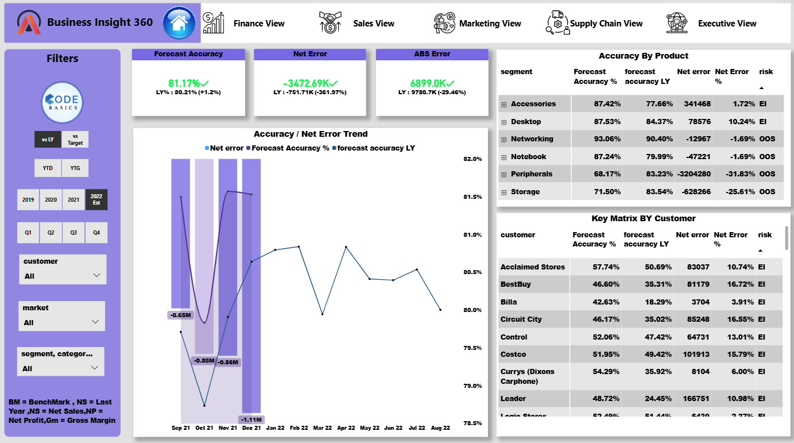


Supply Chain View
WARDIERE BUSINESS
WARDIERE BUSINESS

Slide 11
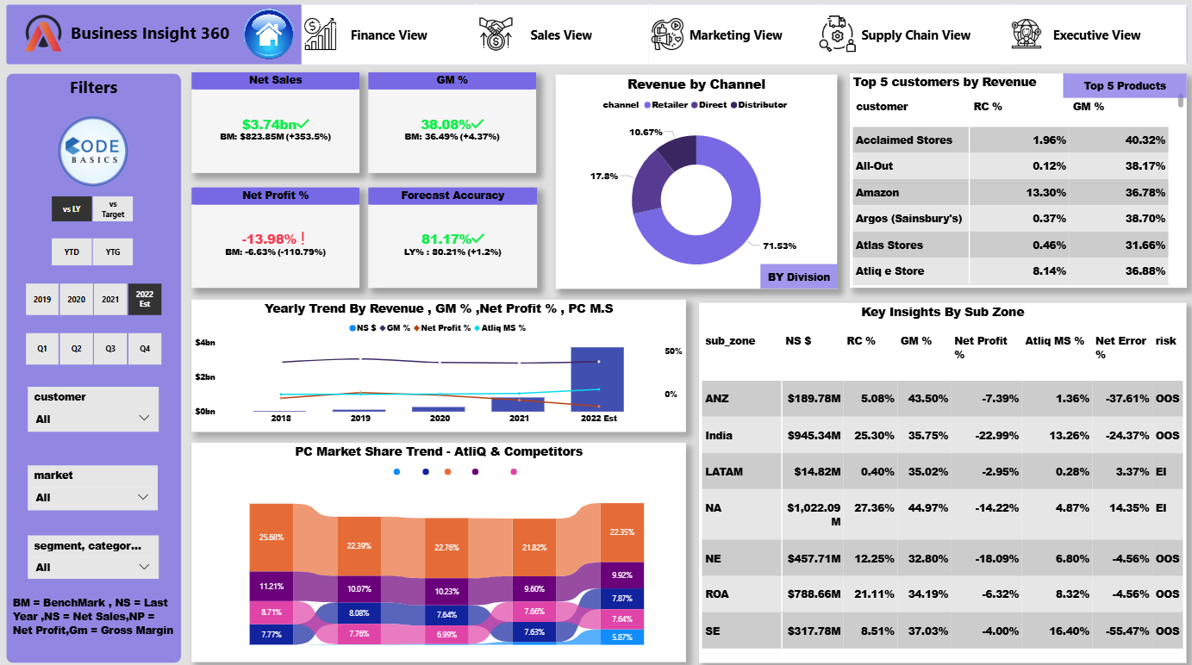
Supply Chain View
WARDIERE BUSINESS
WARDIERE BUSINESS

Slide 12
Key Insights
AtliQ Hardwares achieved 1.64B in Net Sales for 2022, a sharp rise from 346.81M last year, reaching 98% of the 1.67B target and demonstrating strong sales growth.
AtliQ recorded $3.74B in net sales (+353.5%) with improved gross margin (38.08%) and forecast accuracy (81.17%), reflecting strong growth and better demand planning. However, net profit declined (–13.98%) due to rising costs and pricing pressures, especially in India and North America. The company remains retail-driven (71.5%), with OOS risks in ANZ and SE, highlighting the need for stronger inventory and cost optimization strategies.
AtliQ Hardwares’ Net Sales showed strong growth from $111.37M in 2019 to an estimated $3.74B in 2022, with benchmark growth rising from 282.57% to 353.5%. However, Net Profit % declined steadily from -0.85% in 2020 to an estimated -13.98% in 2022, while Gross Margin % dropped from 41.21% in 2019 to 36.49% in 2021, before a slight recovery to 38.08% in 2022, indicating robust revenue expansion but increasing cost pressures impacting profitability
Suggestions
Optimize marketing and operating expenses to improve profitability.
Increase focus on underperforming regions (LATAM, SE) through tailored sales strategies.
Implement dynamic pricing models to balance growth and profit margins.
The LATAM region’s losses appear to be primarily driven by rising marketing and operational costs, which have significantly impacted profitability.
Reallocate budget toward high-performing channels and markets with measurable conversion rates.
Leverage data-driven marketing analytics to evaluate ROI per campaign.
Overall forecast accuracy improved slightly to 81.17% (+1.2% YoY), with net error reducing to –3.47M and ABS error down 29.46%, indicating better demand alignment; however, Peripherals and Storage show low accuracy and OOS risk, while customers like Boulanger, Chip 7, and Argos face high forecast variance, signaling the need for stronger inventory and demand coordination.
.
Improve demand forecasting models using real-time sales data and historical trends.
Strengthen inventory planning to reduce OOS and overstock situations.

Slide 13

Thank You
navinrapelli4@gmail.com

